Slide 1
LEADERSHIP
Technical University in Košice, Slovakia
Radka ČOPKOVÁ
Denisa ROVENSKÁ
Ján BULECA
Martina HORKOVÁ
October 2018

Slide 2
Who we are ...?
RADKA ČOPKOVÁ
Technical University of Košice
Assistant Professor
Psychology, social psychology, developmental psychology, pedagogical psychology, communication, emtions and motivation, socio-psychological training
DENISA ROVENSKÁ
Pavol Jozef Šafárik University in Košice
Assistant Professor
psychology, social psychology, socio-psychological training
JÁN BULECA
Technical University of Košice
Associate Professor
Household finance, corporate finance, agro-economics
Soft skills trainer and lecturer
MARTINA HORKOVÁ
Leader of NGO in Slovakia
Responsible for writing, implementing and coordinating educational and Erasmus+ youth projects for 4 years
Led business group of 500+ people for 6 years
Certified lecturer for adult education

Slide 3
...and where do we come from?
Slovakia
https://www.youtube.com/watch?v=AFFJ4Zil0Vc

Slide 4
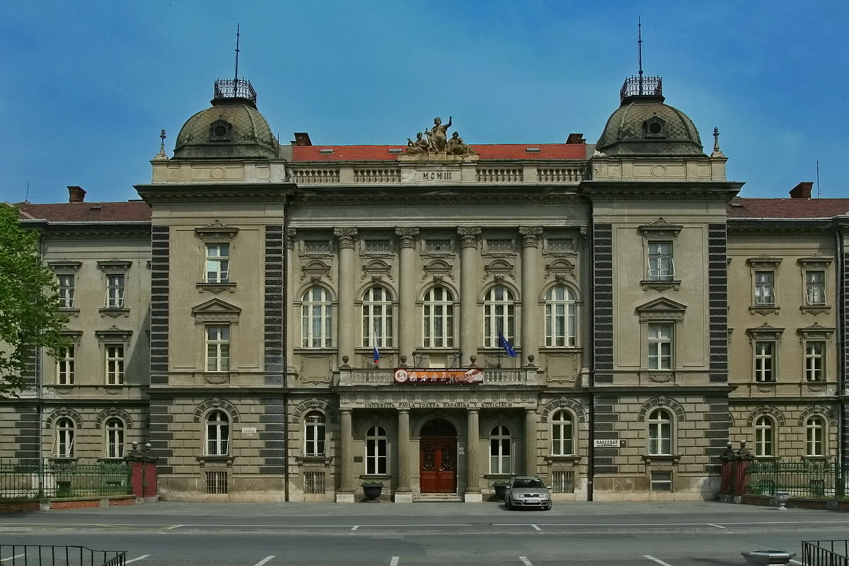
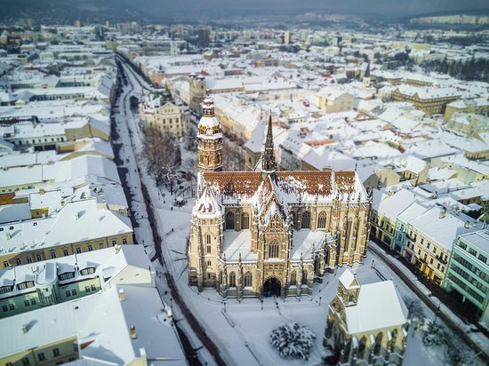
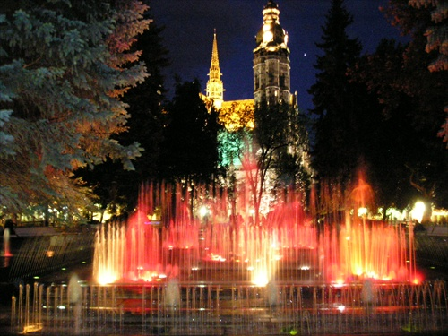
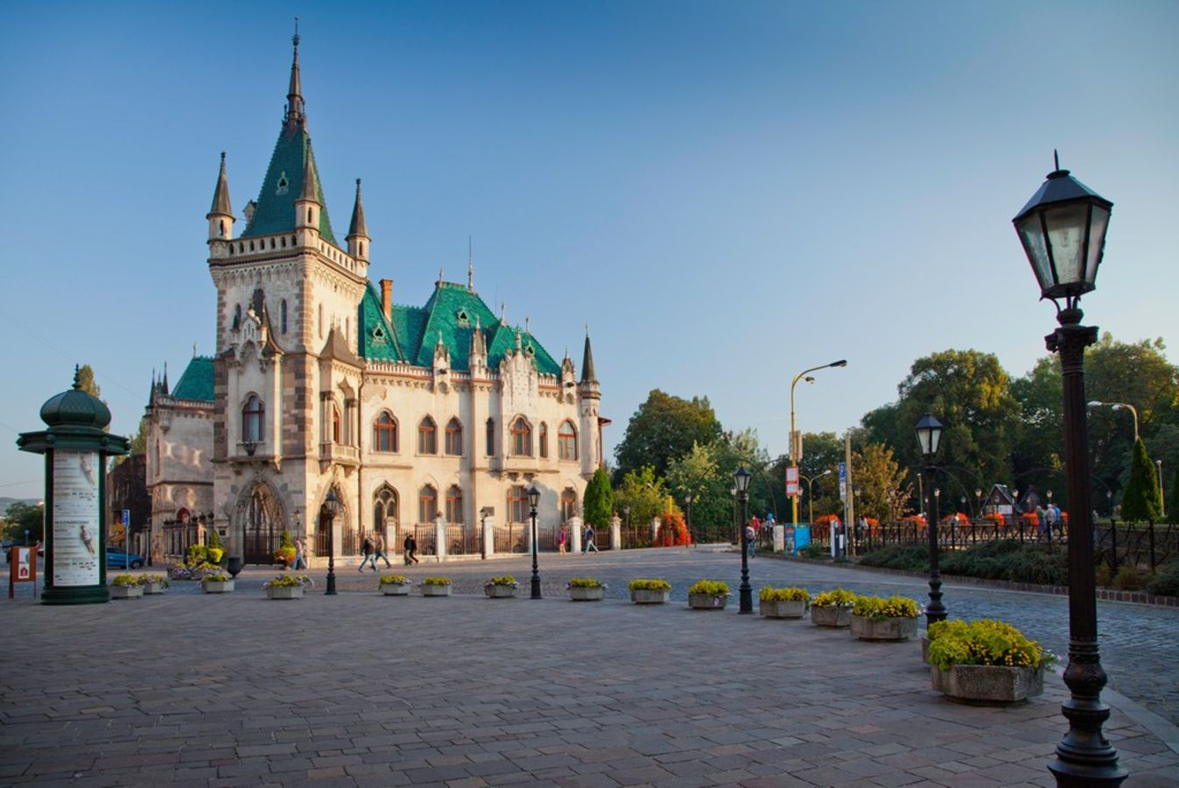

Slide 5
Objectives of the Module 3 „Leadership“
Identify leadership styles.
Be able to distinguish between cognitive, interpersonal, strategic and business skills.
Improve strategic skills.
Identify problems of goal attainment.
CONTENT:
Improvement of cognitive, interpersonal, business and strategic skills
Getting to know the basic strategies of goal setting.
Improvement of planning, realizing and organizing of teamwork during goal attainment
Identification of common problems in goal attainment – obstacles, coping, solutions

Slide 6
CONTENT - Day 1st
The theory of leadership
Skills
Hard skills
Soft skills
Leader
Traits
Behavior
Skills

Slide 7
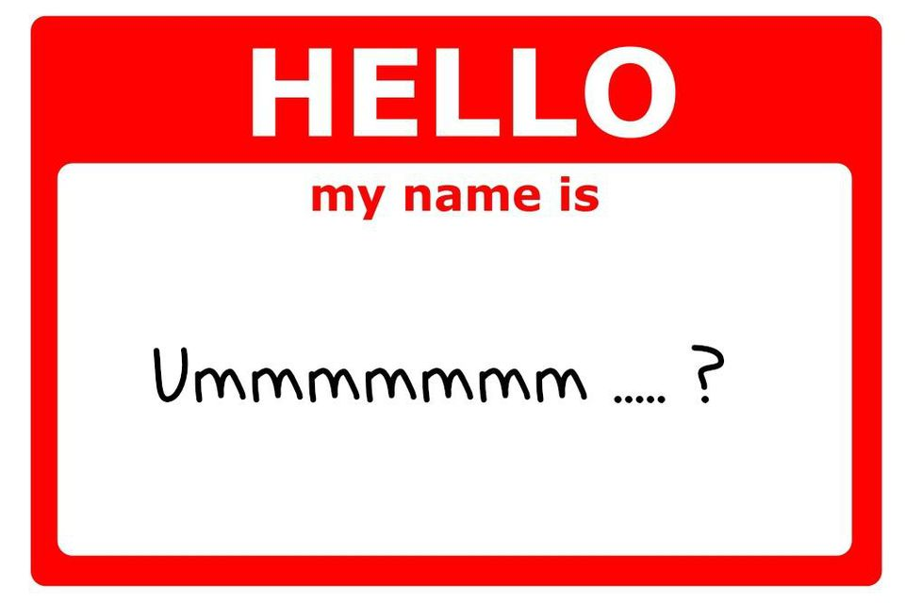
Activity 1 MAKE YOUR OWN NAME TAG
“My name is…”
prefix your name with personal characteristic that describes you
the initial letter of your name must be the initial letter of your personal characteristic
“...and I expect...”
what do you want to happen in this learning event ?

Slide 8
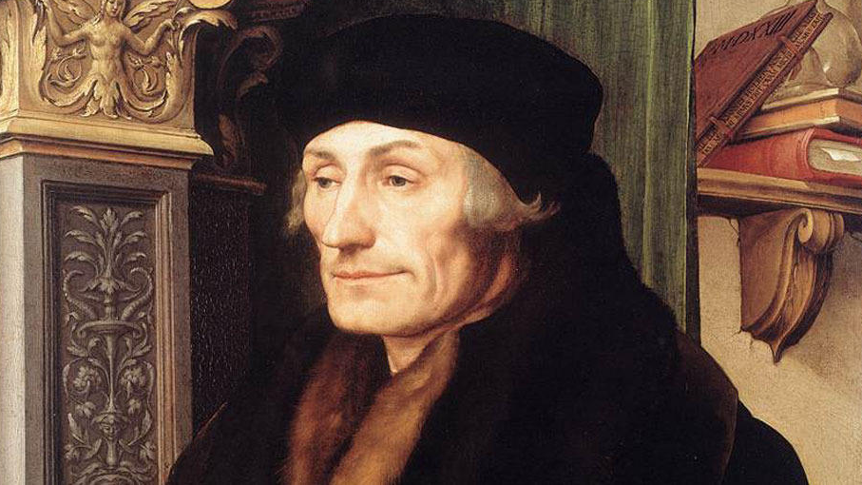
“The best hope of a nation lies in the proper education of its youth.”
Erasmus

Slide 11
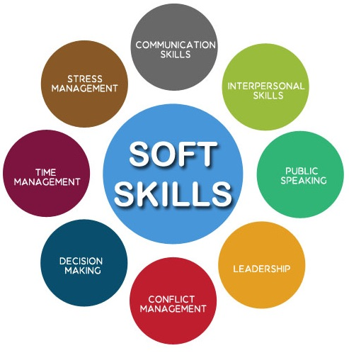

Slide 12
Activity 2 PICTURE A LEADER

Slide 13
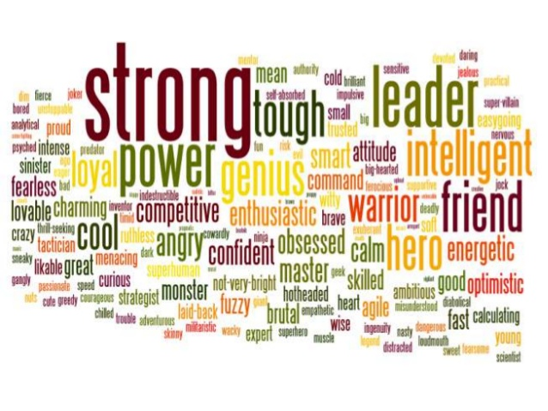
Activity 2 PICTURE A LEADER
WHAT SHOULD BE A LEADER LIKE?
„Take some paper and try to draw a leader and make a list of characteristics expected of a leader.“

Slide 14
Title
LEADERSHIP
is a process of motivating people
to work together collaboratively
to accomplish great things.
(Vroom & Jago, 2007)
Seniority
Position
in a hierarchy
EMPOWERMENT
OF OTHERS
SERVANTSHIP
Management
INFLUENCE
FOLLOWERS

Slide 15
THE LEADER
Leader → 3 important functions:
provide strategic direction and vision to groups/organizations;
engage in motivation and coaching behaviors;
enforcement and interpretation of organizational policies.

Slide 16
THE LEADER
Leader´s traits
personality - honesty, decisiveness, openness, conscientiousness, self-confidence, ethics, optimism, loyalty
Leader´s behavior
behavior - building trust, acting with integrity, inspiring others, encouraging innovative thinking, coaching people, rewarding achievement
Leader´s skills (Mumford et al., 2007)
cognitive skills - self-presentation, asertivity, speaking, active listening
interpersonal skills - emotional intelligence, motivation, self-control
business skills - conflict management
strategic skills - goal setting

Slide 17
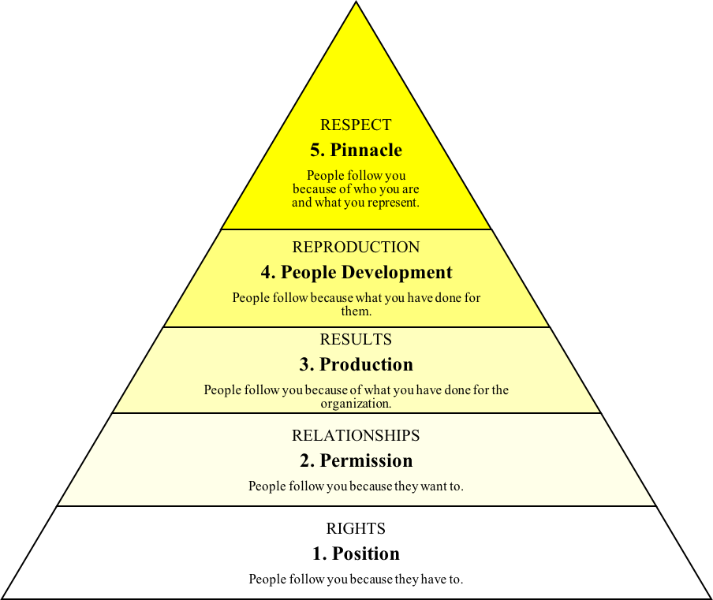
5 Levels of Leadership
Growth is the great separator of those who succeed long term and those who do not.

Slide 18
People follow you because they have to.
1. Level of Leadership
Positional leaders focus on control instead of contribution.

Slide 19
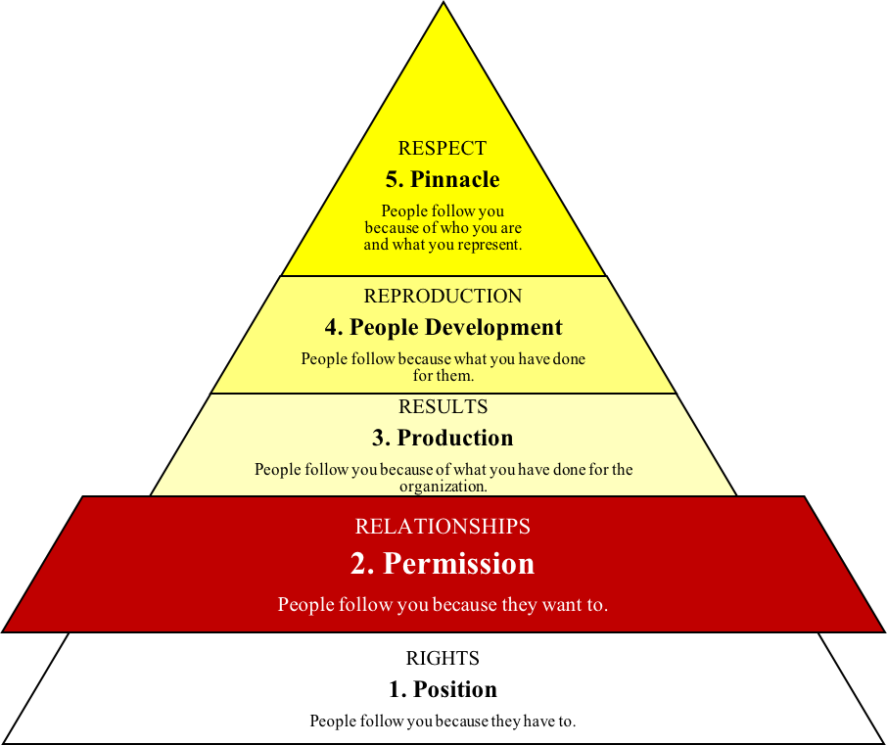
2. Level of Leadership
People follow you because they want to.
You can like people without leading them, but you can not lead people well without liking them.

Slide 20
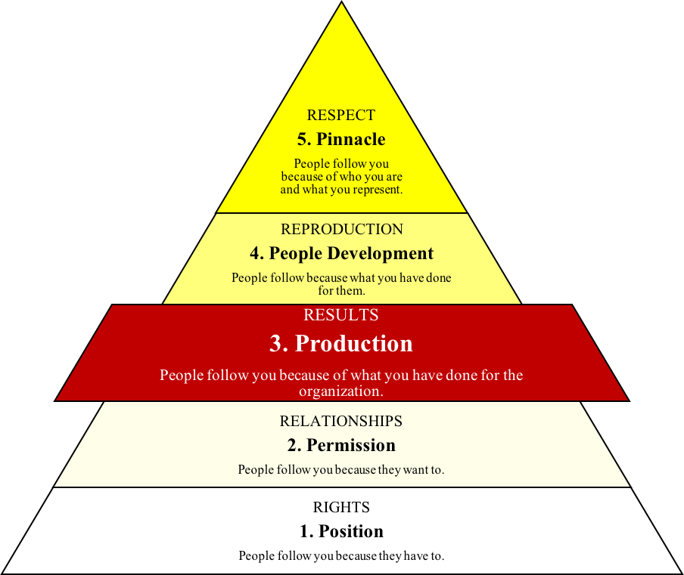
3. Level of Leadership
People follow you because of what you have done for the organization.
The credibility of a Level 3 leader can be summed up in one word: example.

Slide 21
4. Level of Leadership
People follow you because what you have done for them.
Your ultimate goal as a leader should be to work hard enough and strategically enough that you have more than enough to give and share with others.

Slide 22
5. Level of Leadership
People follow you because of who you are and what you represent.
You are willing to invest your life into the lives of others for the long haul.

Slide 23
Activity 3
SPEAK, LISTEN AND OBSERVE
Cognitive skills
the core skills your brain uses to think, read, learn, remember, reason, and pay attention

Slide 24
Activity 3
SPEAK, LISTEN AND OBSERVE
group of 3 people → 3 different roles (each other)
Speaker: speak about your qualities during 5 minutes
Listener: listen accurately, listen precisely
Observer: observe how a speaker acts
„Get into a groups of 3 people. Each of you have 5 minutes to speak on your own working qualities/good characteristics/skills.
Other people in your group just listen to you or observe you with no response. The roles will change after 5 minutes.“

Slide 25
Activity 3
SPEAK, LISTEN AND OBSERVE
Speak → self-presentation - expressing oneself and behaving in ways that create a desired impression
Listen → active listening - listen to obtain information, listen to understand, listen to learn
Observe → non-verbal factors - observe the details very keenly and report it (body language, voice, distance, etc.)

Slide 26
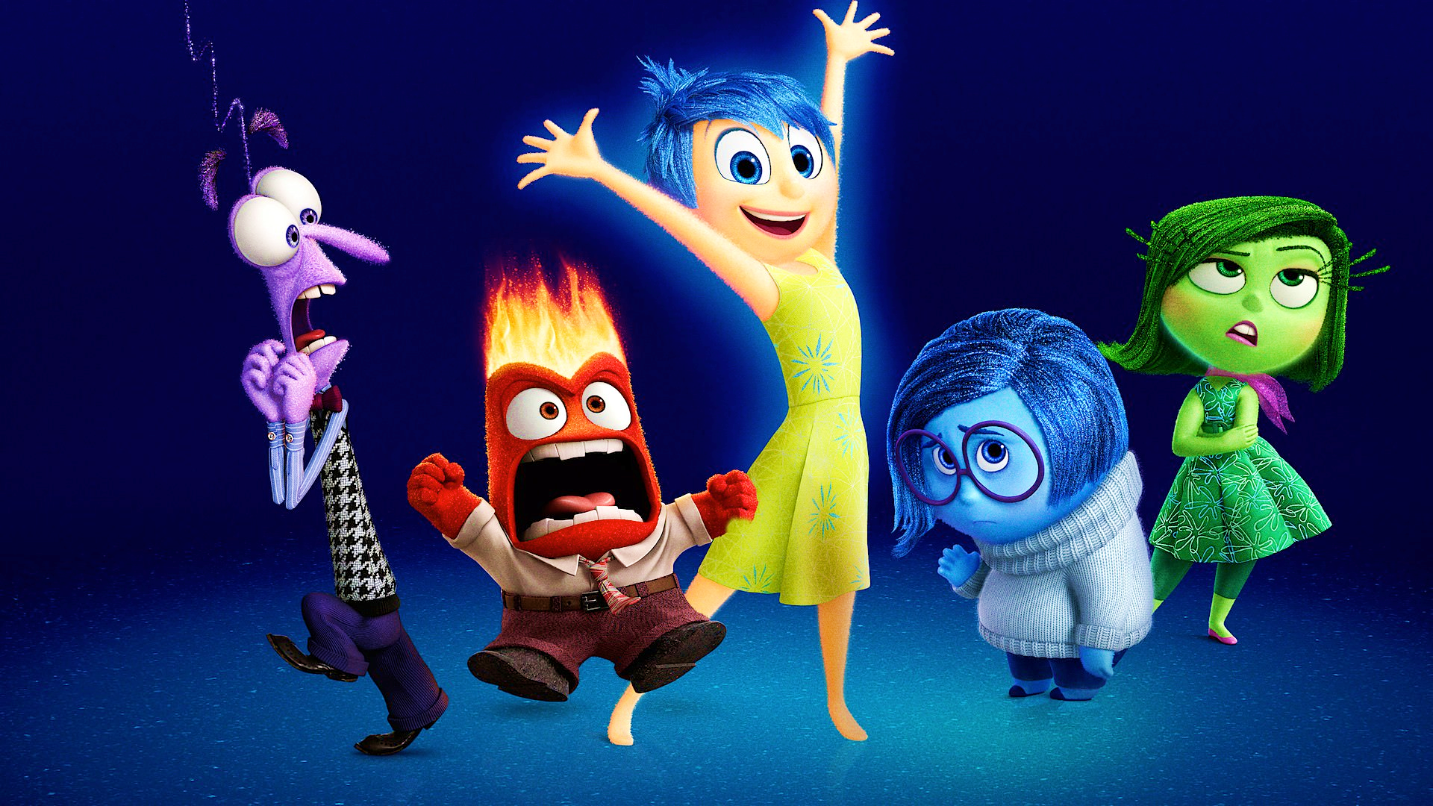
Activity 4
EMOTION DICE GAME
Interpersonal skills
refers to an one's ability to get along with others

Slide 27
Activity 4
EMOTION DICE GAME
HAPPINESS
SADNESS
ANGER
FEAR
DISGUST
SURPRISE
„Roll a dice and try to remind the last situation in your work (except of today) when you have been feeling an emotion reflecting the number.“

Slide 28
Emotional Intelligence
the ability to monitor one´s own and others emotions, to discriminate among them and to use information to guide one´s thinking and action
SELF-AWARENESS (humility, strengths, weaknesses)
SELF-REGULATION (staying in control)
SELF-MOTIVATION (high standards for the quality of work)
EMPATHY (putting in someone else's situation)
SOCIAL SKILLS (great communication)

Slide 29
Provided by...
perceiving (What do I feel?)
understanding (What does it mean when I feel like this?)
using (If I´m calm, I can think clearly)
managing emotions (I have to calm down)

Slide 30
Activity 5 CONFLICT MANAGEMENT STYLE
Business skills
basic skills such as communication, influencing, negotiation and line management, management of financial, personal and material resources

Slide 31
CONFLICT
an interactive process manifested in incompatibility, disagreement, or dissonance within or between social entities
occurs when one (two) social entity (ies):
is required to engage in an activity that is incongruent with his/her needs or interests;
holds behavioral preferences the satisfaction of which is incompatible with another person´s implementation of his/her preferences;
wants some mutually desirable resource that is in short supply, such that the wants of everyone may not be satisfied fully.

Slide 32
CONFLICT
Conflict has productive potentials...

Slide 33
CONFLICT
Conflict has productive potentials...
Functional outcomes:
conflict may stimulate innovation, creativity, and change
organizational decision making processes may be improved
alternative solutions to a problem may be found
conflict may lead to synergistic solutions to common problems
individual and group performance may be enhanced
individual and groups may be forced to search for new approaches

Slide 34
CONFLICT
... as well as destructive potentials
Dysfunctional outcomes:
conflict may cause job stress, burnout, and dissatisfaction
communication between individuals and groups may be reduced
a climate of distrust and suspicion can be developed
relationships may be damaged
resistance to change can increase
organizational commitment and loyalty may be affected

Slide 35
Activity 5 CONFLICT MANAGEMENT STYLE
Rahim Organizational Conflict Inventory-II (Rahim, 1983)
a 28 item questionnaire measuring conflict management styles
5 independent dimensions of the styles of handling interpersonal conflict:
integrating (IN)
obliging (OB)
dominating (DO)
avoiding (AV)
compromising (CO)

Slide 37
SUMMARY of the Module 3 objectives
Identify leadership styles.
Be able to distinguish between cognitive, interpersonal, strategic and business skills.
Improve strategic skills.
Identify problems of goal attainment.
CONTENT:
Improvement of cognitive, interpersonal, business and strategic skills
Getting to know the basic strategies of goal setting.
Improvement of planning, realizing and organizing of teamwork during goal attainment
Identification of common problems in goal attainment – obstacles, coping, solutions

Slide 38
Thank you for your attention ☺ See you tomorrow

